Slide 1

AWE WEBINAR 18 March 2021
Outdoor events around the
Atlantic Wall in Holland
By Geert-Jan Mellink, member of the board of the Foundation for European Heritage Atlantic Wall in Holland

Slide 2
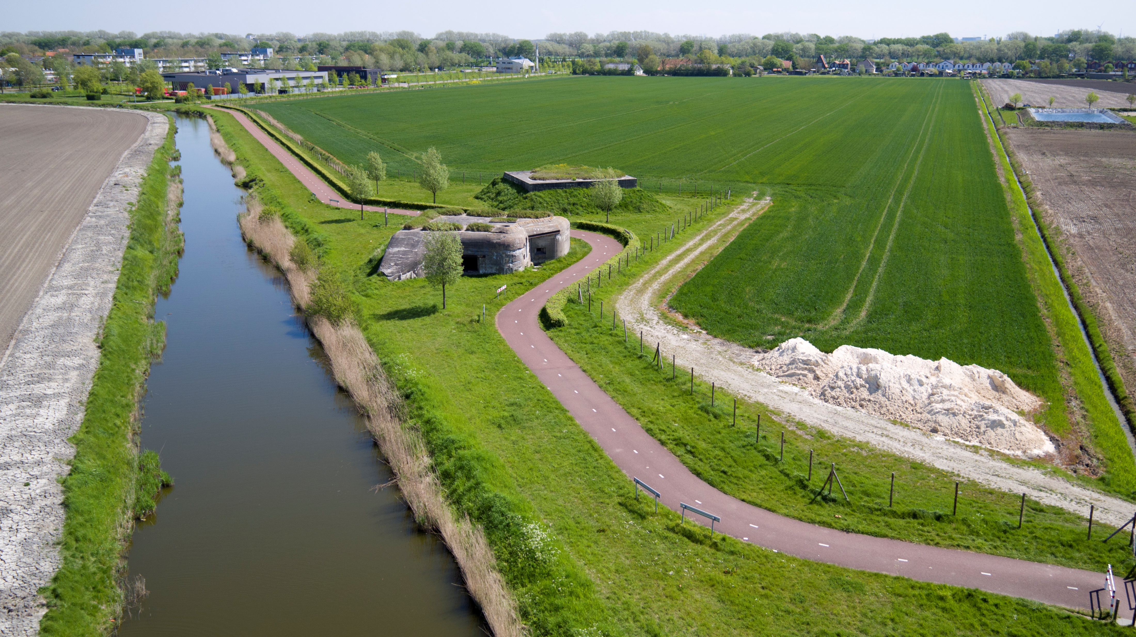
Biking or walking along a tankditch with strongpoints

Slide 3
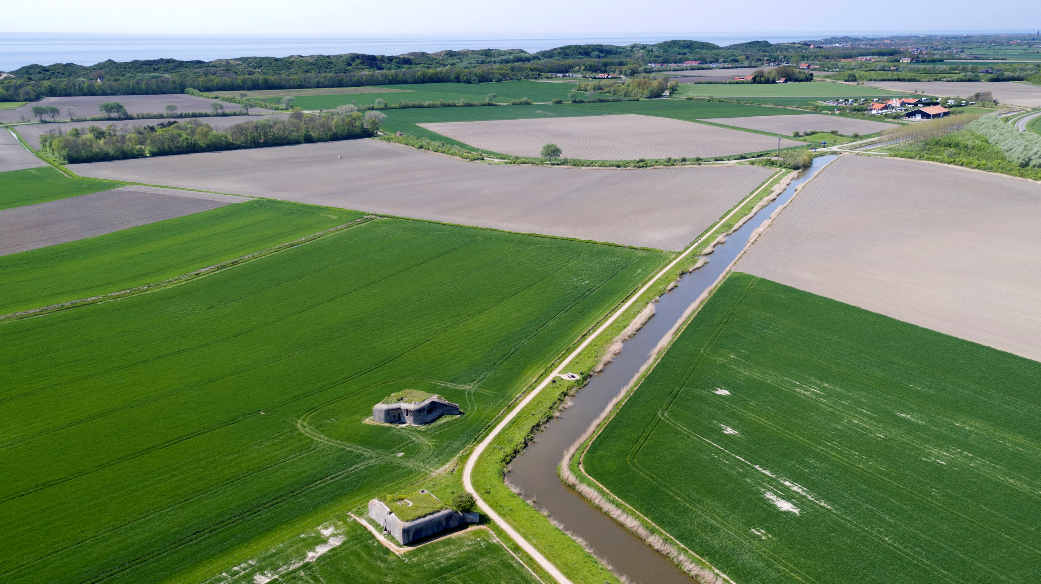

Slide 4
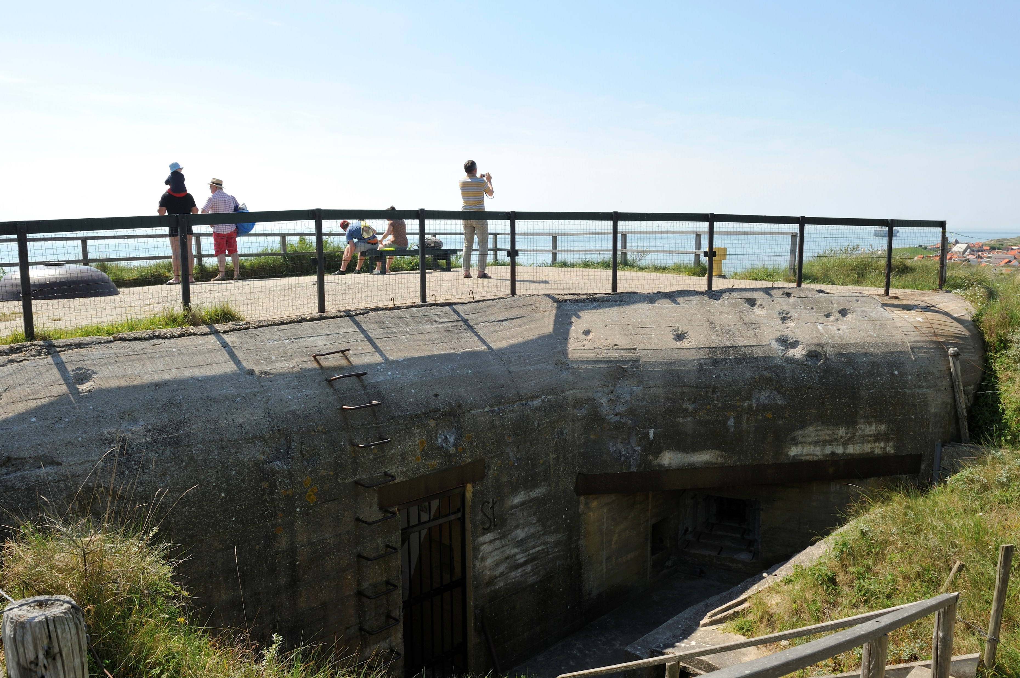
Visiting bunkers with a viewpoint

Slide 5
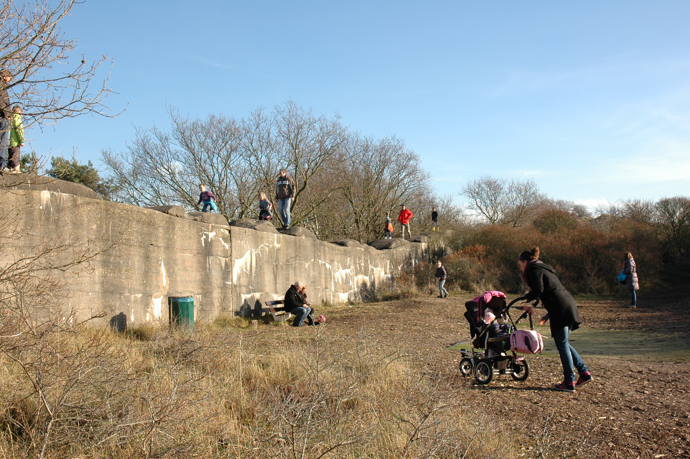
Climbing a tank wall

Slide 6
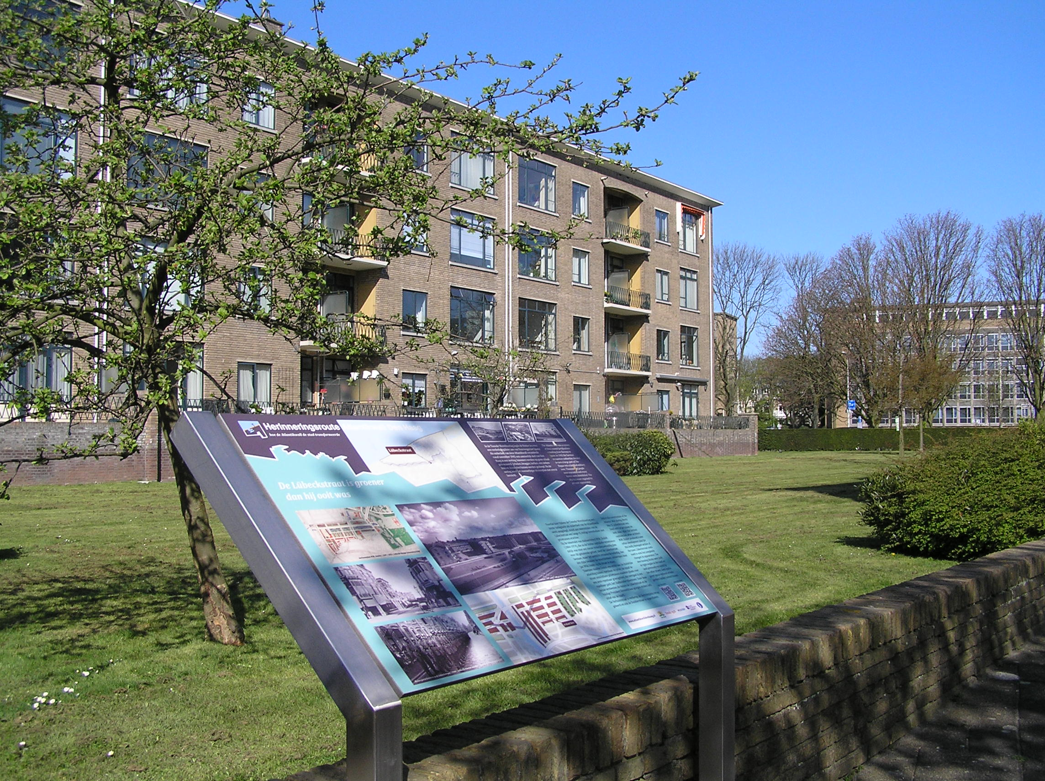
Walking a Atlantic Wall route

Slide 7
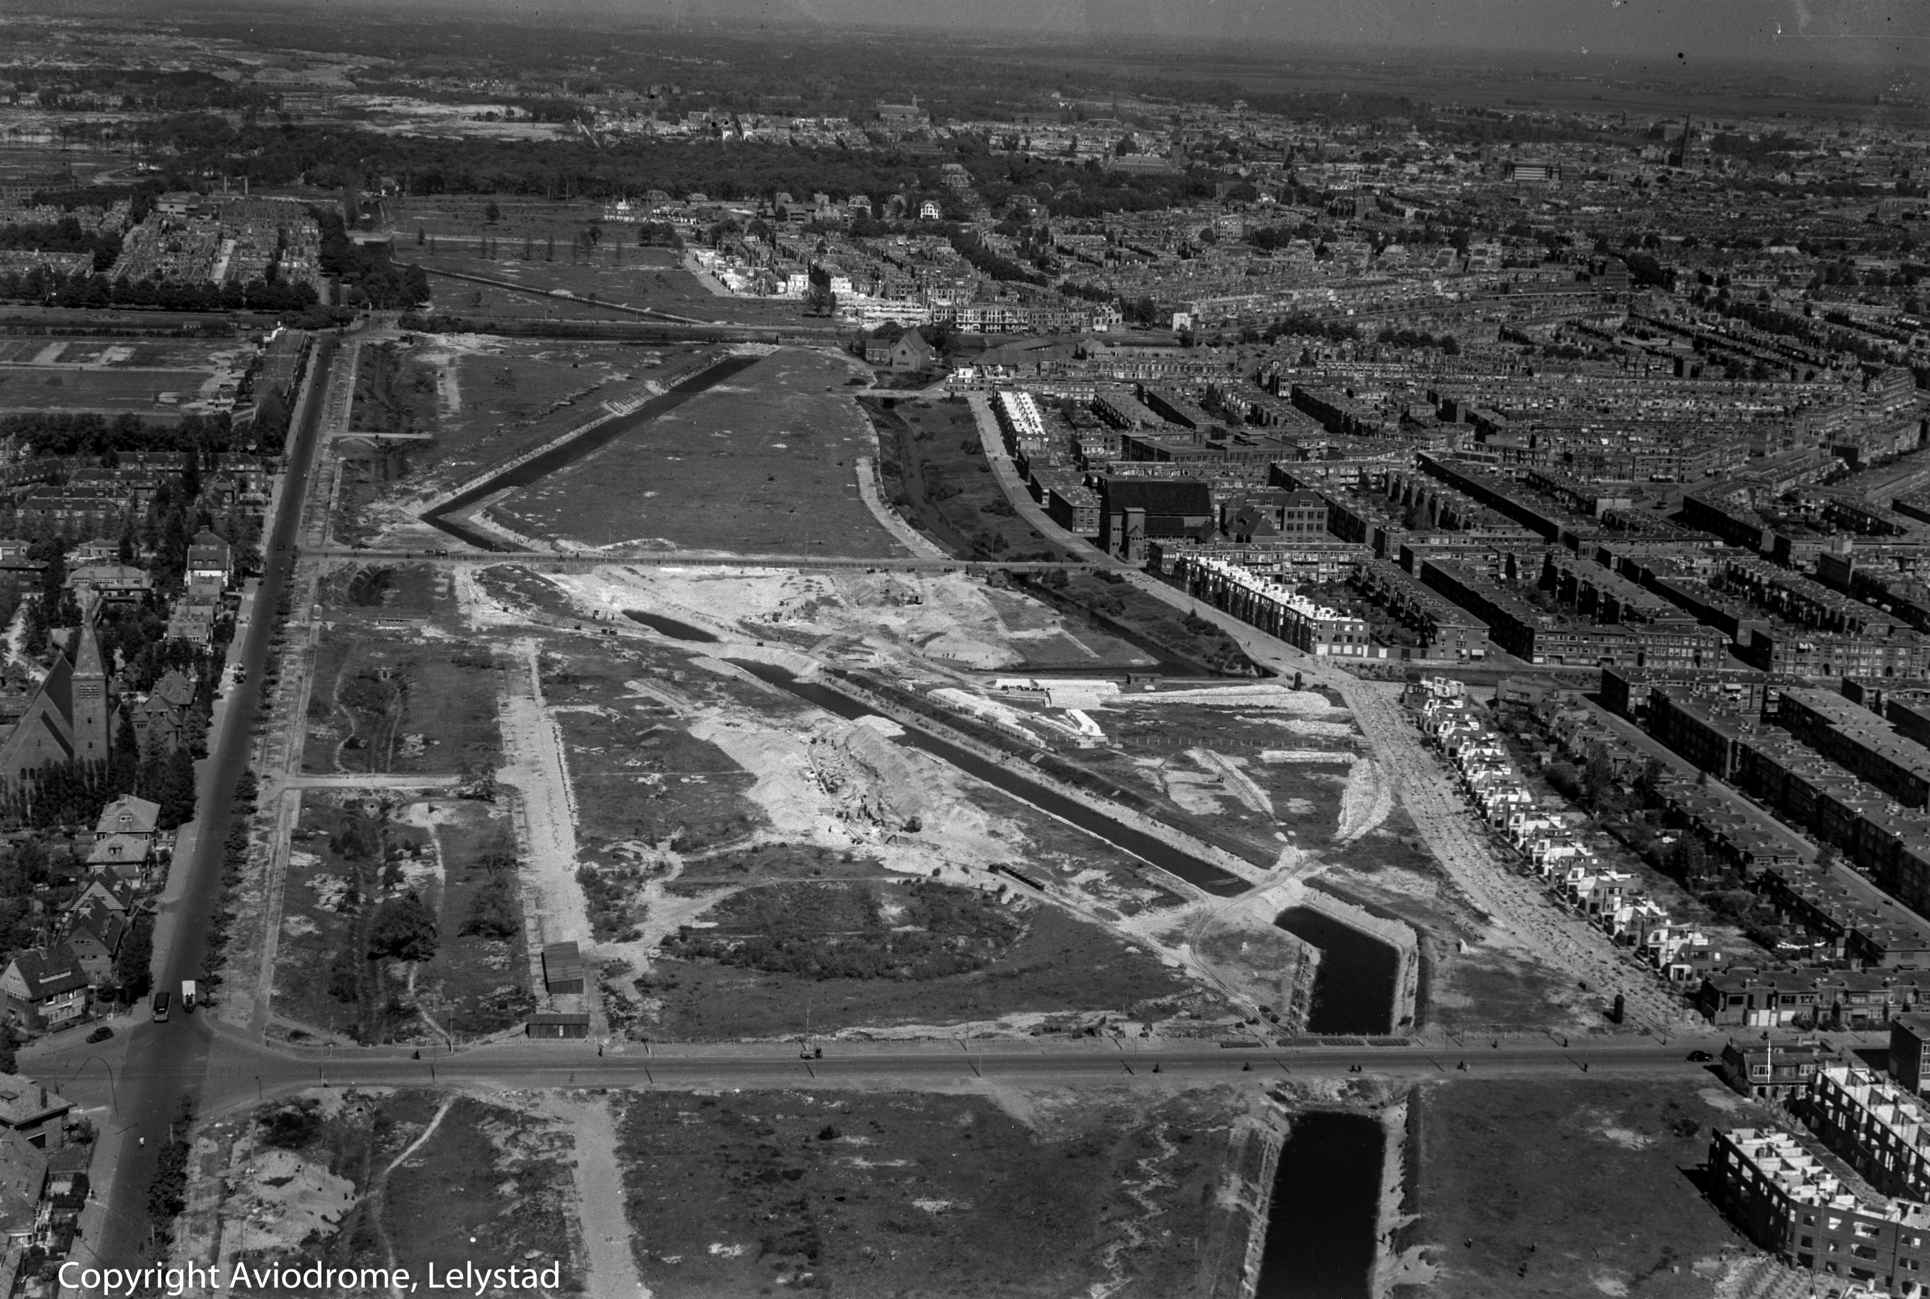

Slide 8
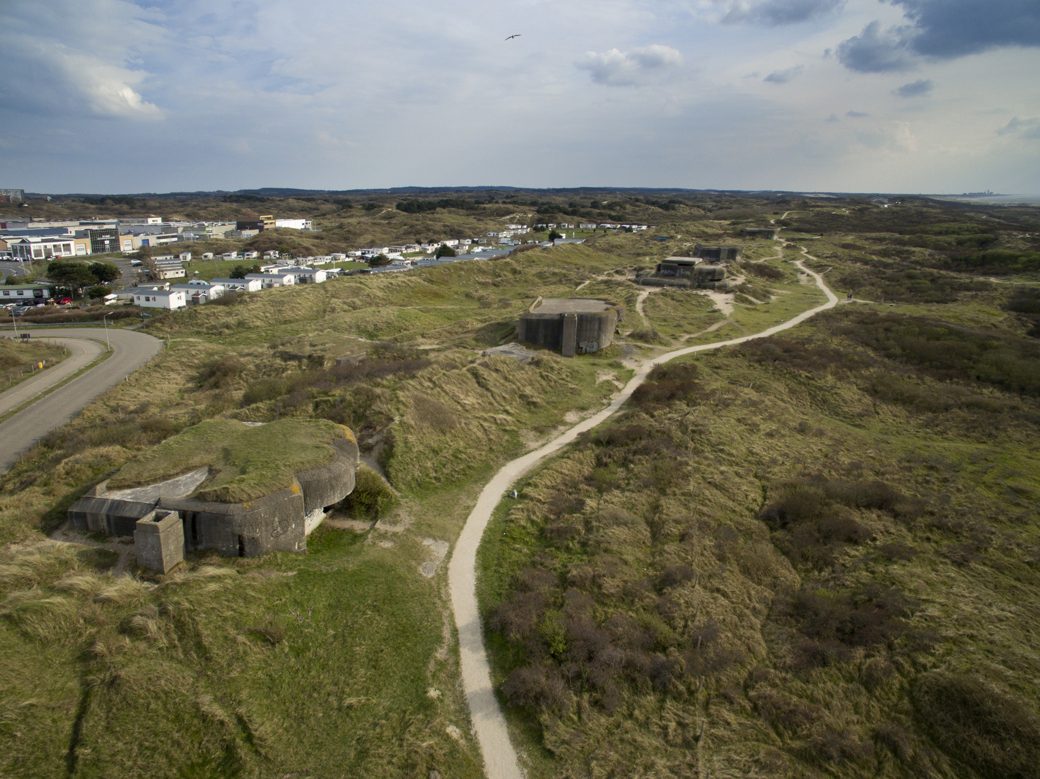
Walking a bunker route

Slide 9
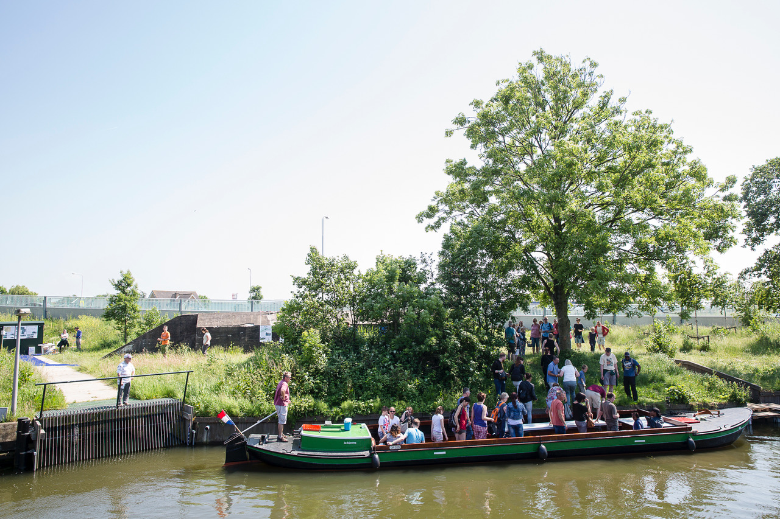
See bunkers by cruising about a tank ditch

Slide 10
