Slide 1

AWE WEBINAR 18 March 2021
OUTDOOR EVENTS AROUND ATLANTIKWALL SITES - CAPACITY BUILDING SESSION
→ Information on Covid-situation per country

Slide 2

1. In the present Covid situation, for your site(s),
- what is your national regulatory situation for events like European Bunker Day ? (max. 5 bullet points on this - only - slide)
Nothing is sure - new information daily
Ruled on county level (at this moment), depending on:
- the 7-days-incidences (</>50 and >100)
- the individual local infrastructure of the bunker/ museum/…
(e.g. size, ventilation, access and exit, …)

Slide 3

2. In the present Covid situation, for your site(s),
- what is impossible to do at this moment under your national Covid-measures? (max. 5 bullet points on this - only- slide)
Face-to-face events inside and outside with more than XX people, depending on:
- the current national/ county rules
- the individual local infrastructure of the bunker/ museum/
fortress…

Slide 4
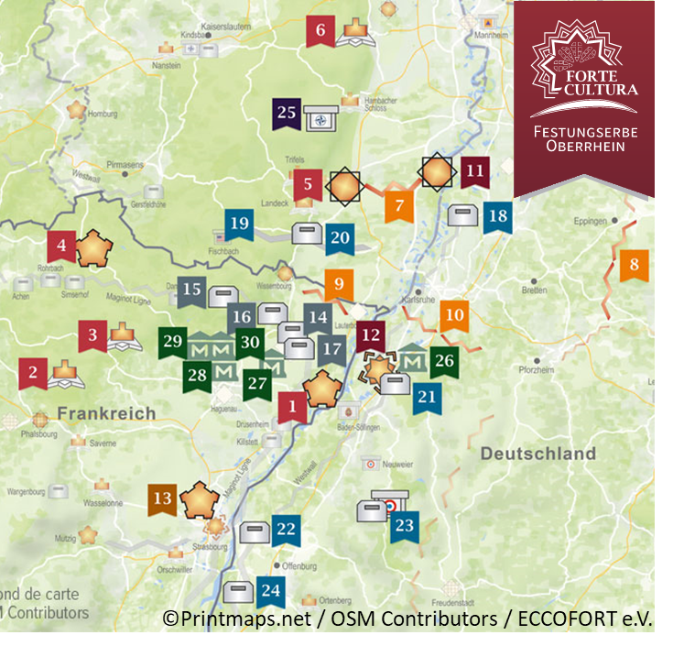
3. In the present Covid situation, for your site(s),
-what is still possible to do / what have you already done under your national Covid-measures? (max. 5 bullet points on this - only - slide)
Hygiene concepts for locations
Network and communication
Qualifying of marketing instruments (online and print)
Partially opened sights
Preparation of upcoming events

