Slide 1

AWE WEBINAR 18 March 2021
OUTDOOR EVENTS AROUND ATLANTIKWALL SITES - CAPACITY BUILDING SESSION
→ Information on Covid-situation per country

Slide 2
1. In the present Covid situation, for your site(s),
- what is your national regulatory situation for events like European Bunker Day ?
No particular Bunker Day in 2021 at our museums
However this year we shall focus on our new museum on the site of an old German military camp in Oksbøl (built 1941) that was later used as af refugee camp for 35.000 German refugees from 1945-49. The new museum is scheduled to open in the summer of 2022
And of course we are also longing to reopen the Tirpitz Museum in Blaavand that is also momentarily closed due to the pandemic.

Slide 3
2. In the present Covid situation, for your site(s),
- what is impossible to do at this moment under your national Covid-measures?
Normally we would have a lot guided tours at the Tirpitz Museum, but that is impossible at the present moment
We still have problems even with outdoor tours, because we are still not allowed to gather more than five people.

Slide 4
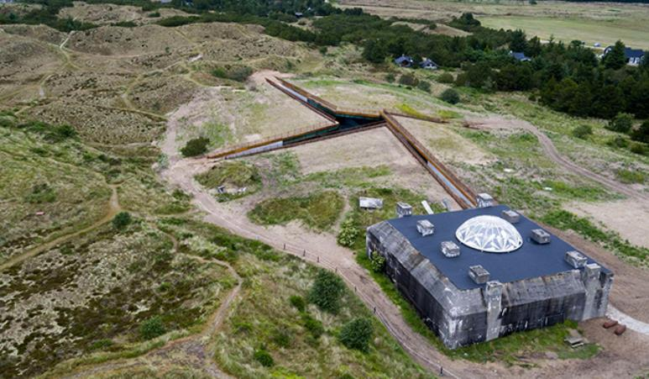
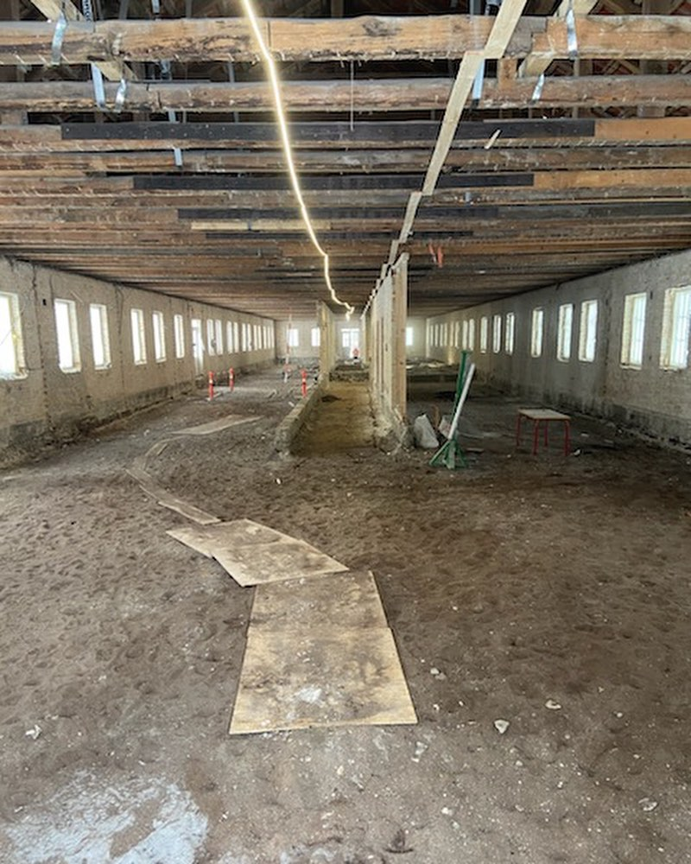
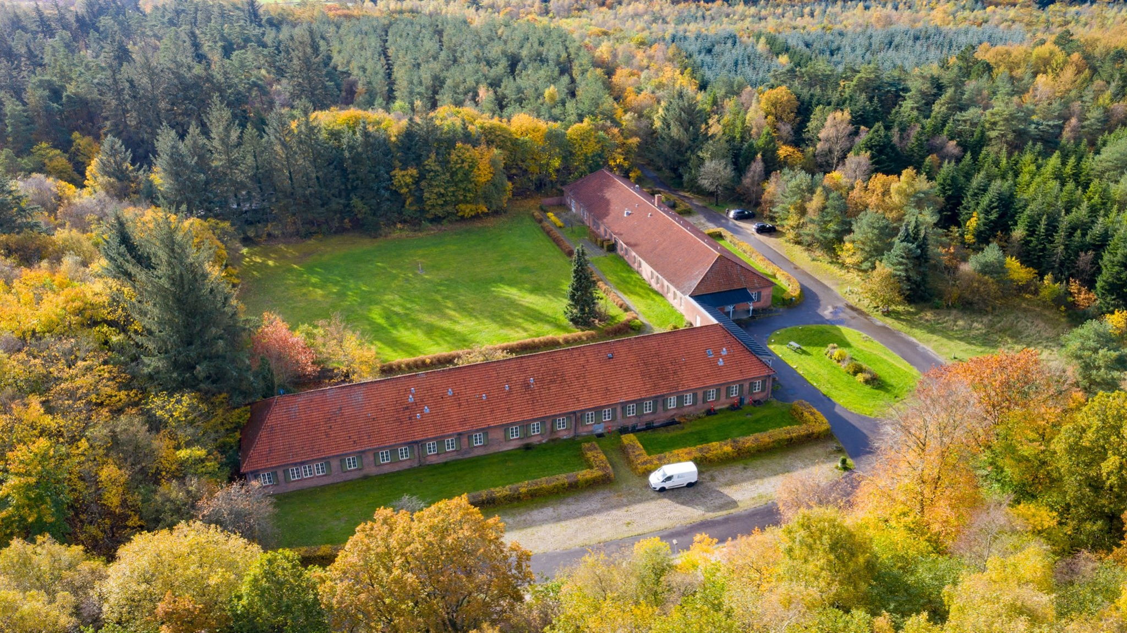
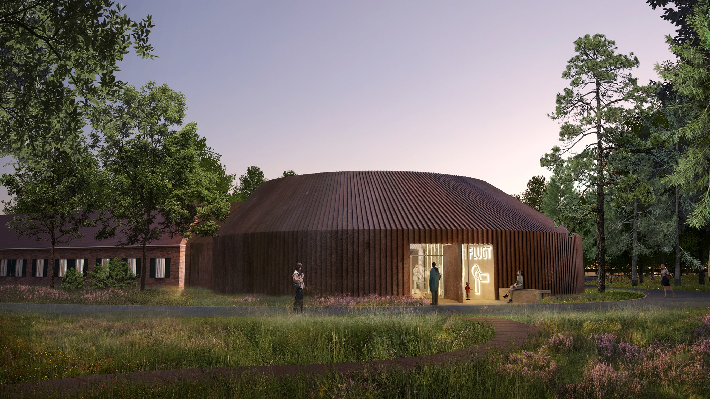
3. In the present Covid situation, for your site(s),
-what is still possible to do / what have you already done under your national Covid-measures?
In the spring around April or May, when hopefully the restrictions are being lifted, we will start making outdoor tours again

