Slide 1

AWE WEBINAR 18 March 2021 OUTDOOR EVENTS AROUND ATLANTIKWALL SITES - CAPACITY BUILDING SESSION → Information on Covid-situation per country

Slide 2
Marco van Baalen
● Chair Stichting Europees Erfgoed Atlantikwall (SEEA)
● Member Steering Group Atlantikwall Europe
● Director Dutch Centre for Intangible Cultural Heritage

Slide 3
Stichting Europees Erfgoed Atlantikwall
● Founded in 2014
● purpose: to disseminate the meaning of the AW as important European Cultural Heritage to a larger public in the Netherlands and Europe
● organiser annual Bunkerday in collaboration with Dutch Bunkersites
● no Bunkersite owner or responsible for bunkers
● facilitator / developper

Slide 4
Bunkerday 2014-2019
● 6 editions
● motto: ‘one day a year all bunkers open for public’
● dozens of bunkersites in the 4 coastal provinces participate and make the event so succesfull
● over 15.000 visitors

Slide 5
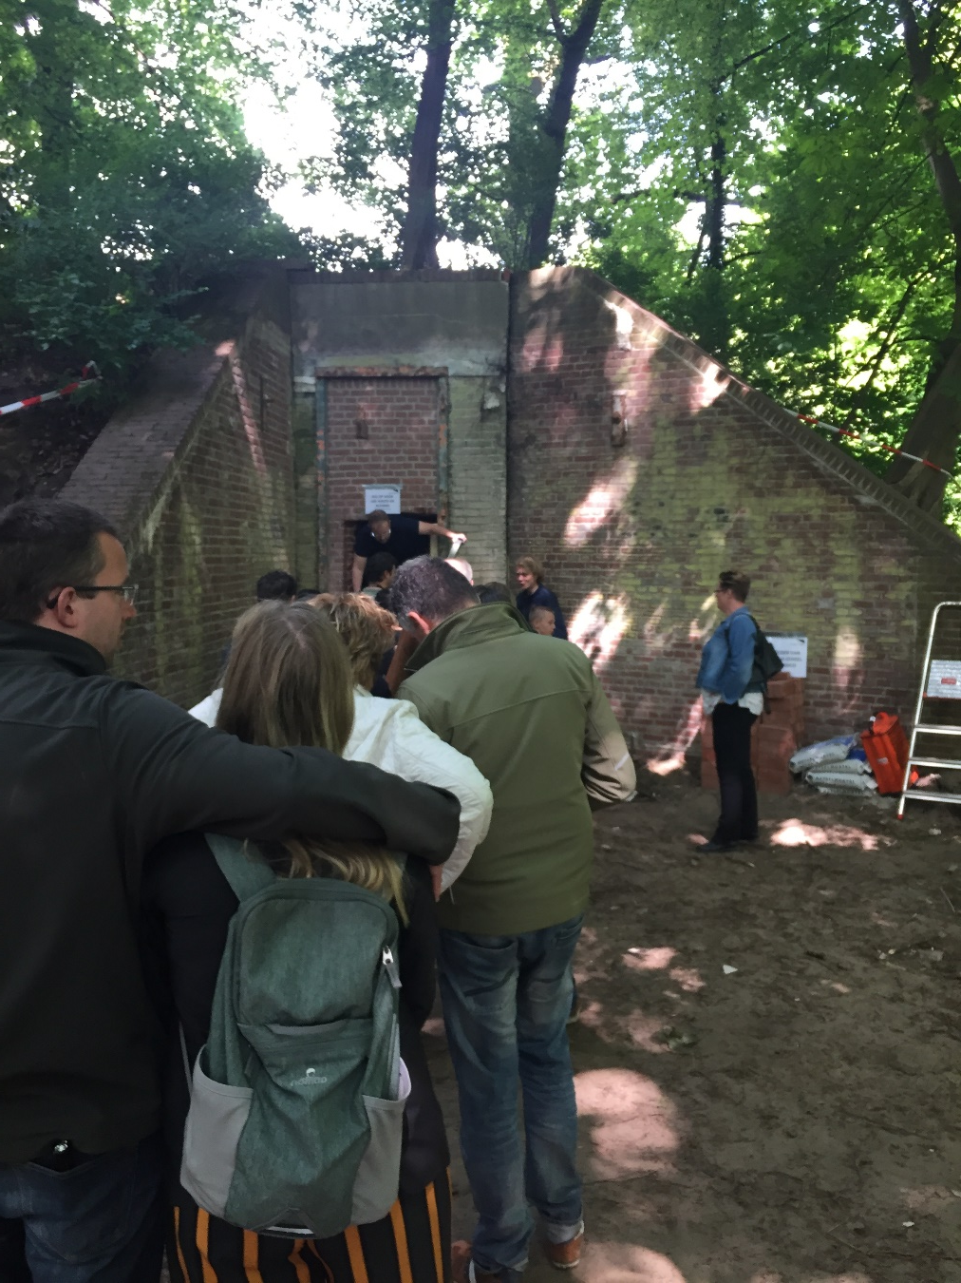

Slide 6
No Bunkerday possible in The Netherlands in 2020 and again in 2021
● Too uncertain perspective
● Funds/government have strict conditions for a coronaproof event that we can not garantee as we are not the owners of the sites
● Funds don’t want a digital Bunkerday
● Living up to expectations public (‘entering bunkers’) can not be upheld
● SEEA is hoping to organise the 7th Bunkerday in 2022!!

Slide 7
1. In the present Covid situation, for your site(s), - what is your national regulatory situation for events like European Bunker Day ? ● No public events allowed until may 5th 2021 in the Netherlands ● No perspective yet what will be allowed after that date

